Slide 1
Hands-on Tutorial: Active learning and transfer learning at scale with R and Python
Mario Inchiosa
Ali-Kazim Zaidi
John-Mark Agosta
Robert Horton
Tomas Singliar
Olga Liakhovich
Vanja Paunic
Hang Zhang

Slide 2
Setting up your Virtual Machine
Instructions at https://github.com/Azure/active-learning-workshop
Open https://hostname:8000 (use https, not http; replace "hostname" with the hostname on the slip of paper you received when arriving). Disregard warnings about certificate errors.
Open a bash terminal window by clicking the New button and then clicking Terminal.
In the bash terminal, run these four commands:
cd ~/notebooks
git clone https://github.com/Azure/active-learning-workshop.git
cd active-learning-workshop
source startup.sh
You can now log in to RStudio Server at http://hostname:8787 (unlike JupyterHub, be sure to use http, not https).

Slide 3
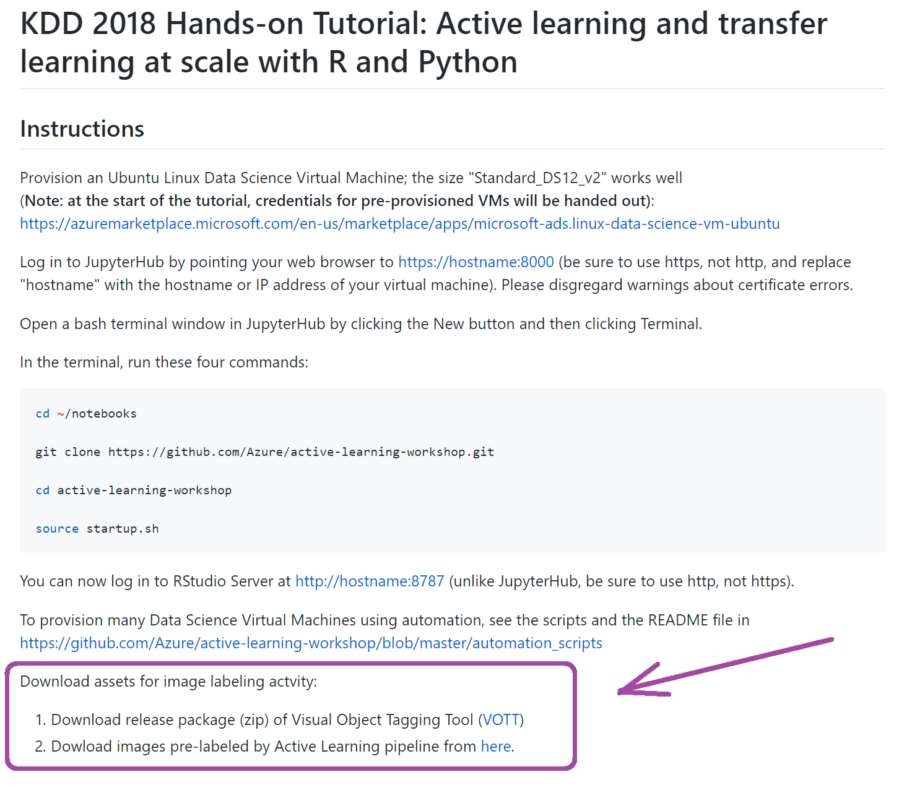
Note: please, download assets for exercise
URLs: are in the tutorial readme
https://github.com/Azure/active-learning-workshop/
Unzip

Slide 4
Session Goals
Learn how to:
use transfer learning from pre-trained deep learning models to generate features that can be used in traditional machine learning approaches.
run these types of featurization at scale.
use active learning to take advantage of large sets of unlabeled data to build more accurate classifiers by selecting the most useful additional examples to label for training.
optimize models by tuning hyperparameters.
deploy models as web services.

Slide 5
Use Cases
Wiki detox
Active learning from text data.
Binary classifier: is this comment a personal attack?
Featurization from pre-trained language model (USE).
Wood knot images
Active learning from image data.
Multi-class classifier: which type of knot is this?
Featurization from pre-trained deep learning model (Resnet)

Slide 6
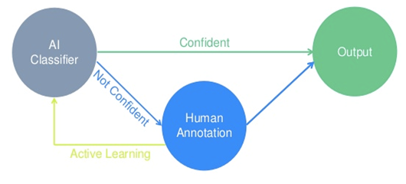
Active Learning
Active Learning intersperses labelling of samples with incremental re-training. The currently trained model is used to select new samples to label. There are variety of approaches for selecting samples, depending on the data and model.
Data (unlabeled) is often easier to come by than expert labelers
* Image taken from https://www.crowdflower.com
Notes:
Data is often easier to come by than expert labels
Use the preliminary model for triage of unlabeled data
What is the model good at? What needs work (e.g., more training data)?
How much of the unlabeled data can we eliminate as already identifiable?
Better model -> better triage -> better selection of cases to label -> better model -> ...
Companies like CrowdFlower and services like the Custom Vision Service use active learning.

Slide 7
Use Case 1: active learning for text classification data, data everywhere

Slide 8
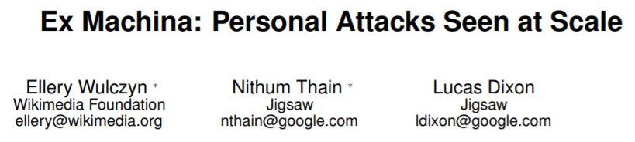
Wikipedia detox dataset
arXiv:1610.08914v2
Preliminary training set
(40 cases)
115k labeled cases
Pseudo-unlabeled cases
(105k)
Test set
(10k)
95M unlabeled cases

Slide 9
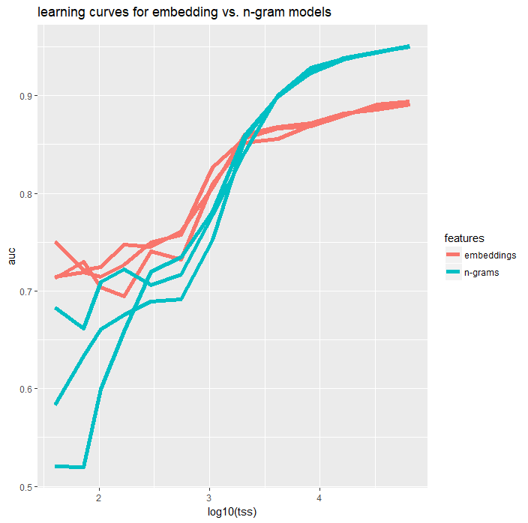
Low complexity models work better with small training sets.
With more data more complex models may give better performance.

Slide 10
Text Featurization with Word Vectors and Universal Embeddings

Slide 11
Capacity and Inductive Biases
performance
neural networks
traditional learners
training data
Revisiting Unreasonable Effectiveness of Data in Deep Learning Era, Google
Notes:
Learning Curves, our trusty friends for understanding the fundamental tradeoffs of bias + variance, and capacity + inductive biases / sample complexity
Two main reasons for the advancement of neural networks have been 1. high capacity models that can learn hierarchy of features [learns good representations] 2. large datasets and cheap compute for learning them [allows us to utilize large
One important salient point: pre-training really helps!

Slide 12
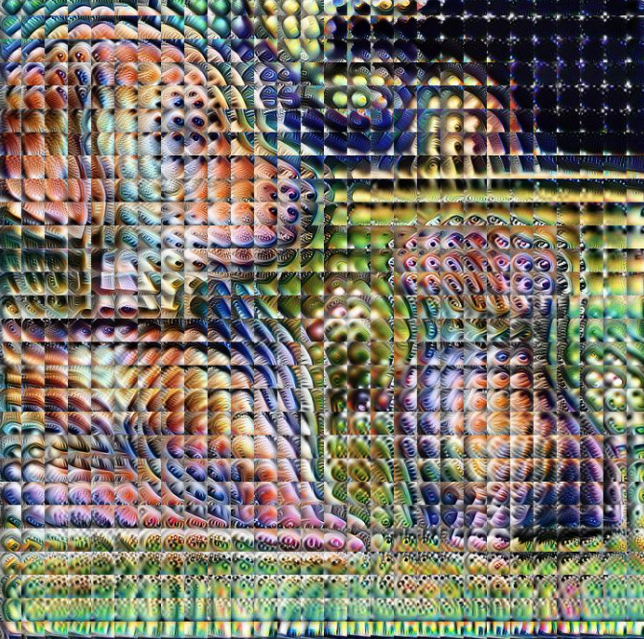
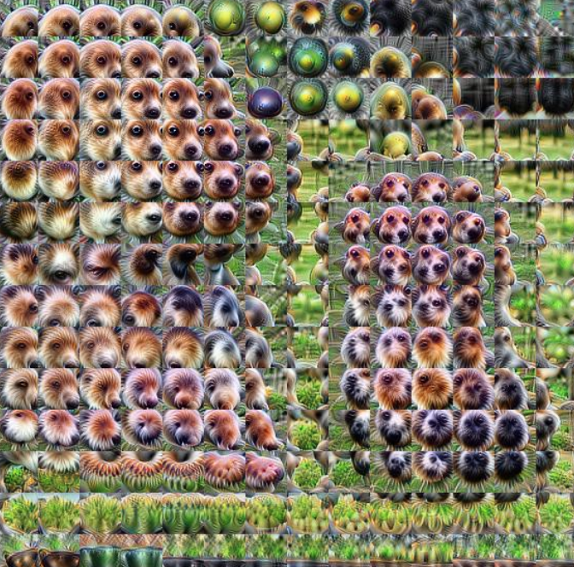
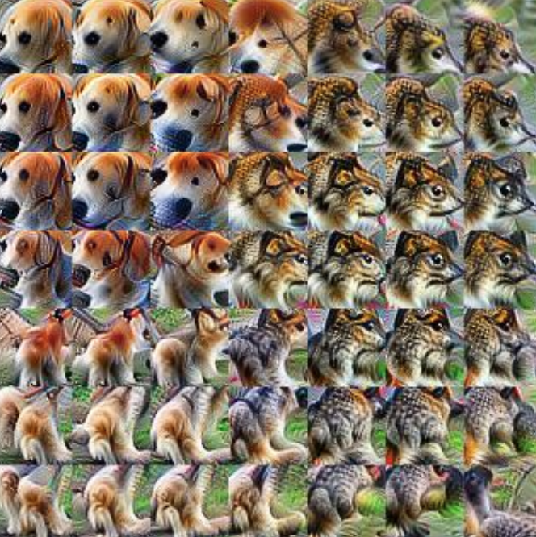
CV: large datasets (ImageNet), good inductive biases (Convolutions + Classification), pre-training + transfer learning has become the norm
NLP: smaller datasets, unsure about the canonical task, stuck at word embeddings, end-to-end models for each task
Notes:
Computer Vision has taken great advantage of pre-training. Perhaps image classification is the canonical task for computer vision. The hierarchy of representations represent gradually more abstract features. ImageNet has provided the public resource of a large dataset for learning these representations, and convolutions (translation invariance) encode useful inductive biases
NLP has been lagging behind. Perhaps we don’t have the right canonical task yet. We don’t have as rich a dataset as imagenet for learning the representations we need. Not enough pre-trained models beyond word embeddings. We can do better.

Slide 13
Data Scarcity, Non-Generalizable Features
Dataset (English) | Size (# sentences)
NER | 15K (CoNLL 2003)
Coreference Resolution | 75K (OntoNotes)
Parsing | 40k (Penn Treebank)
Q&A | 100K questions (SQuAD)
Textual Entailment | 570K (SNLI)
Sentiment Analysis | 10K (SST)
Most SOTA NLP results are obtained from end-to-end models
Most datasets are in English, very small
Not much knowledge sharing or re-use
Single task learning inhibits us from general language understanding, exposes us to overfit discriminative features (poor generalization performance)

Slide 14
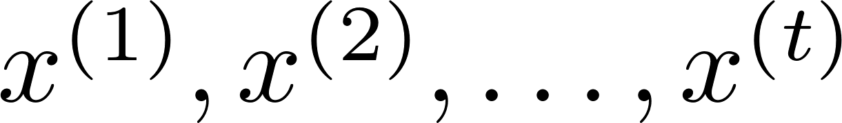
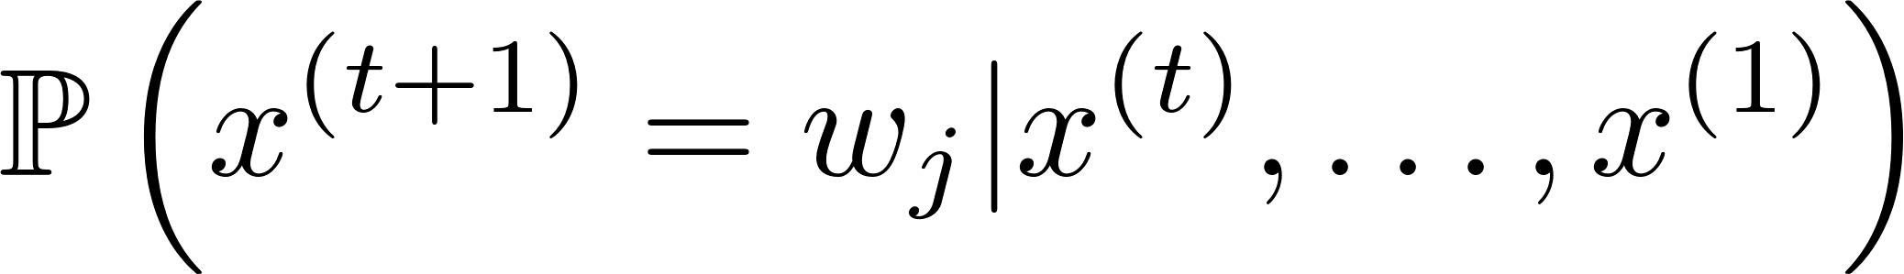
What’s The Canonical Task for Language?
Language modeling: predict the next word given the preceding words:
Given a sequence of words , , compute the CPD:
Completely unsupervised / self-supervised
Can leverage large unlabeled corpora, like Wikipedia, news, twitter, etc.
Might be the canonical task for NLU, e.g., Language Modeling Teaches You More than Translation Does: Lessons Learned Through Auxiliary Task Analysis, 2018
Other work has argued for NMT, McCann et. al 2017, Learned in Translation, dialogue, Q&A, McCann et. al 2018
Notes:
Language modeling may encode a useful inductive bias for us. If we have a statistical model about the likelihood of a sentence, we can compute inferential statements about sentences / phrases.
Can take advantage of large corpora.
Some drawbacks: hard to encode long-enough dependencies to reason about some recursive concepts. The right inductive bias may have too high sample complexity / computational complexity (too sequential for our data-hungry GPUs)
Socher’s Goal: everything should be Q&A

Slide 15
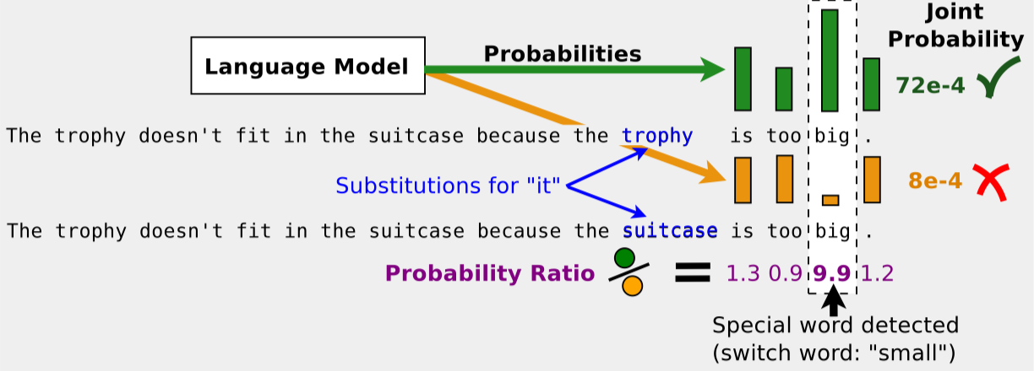
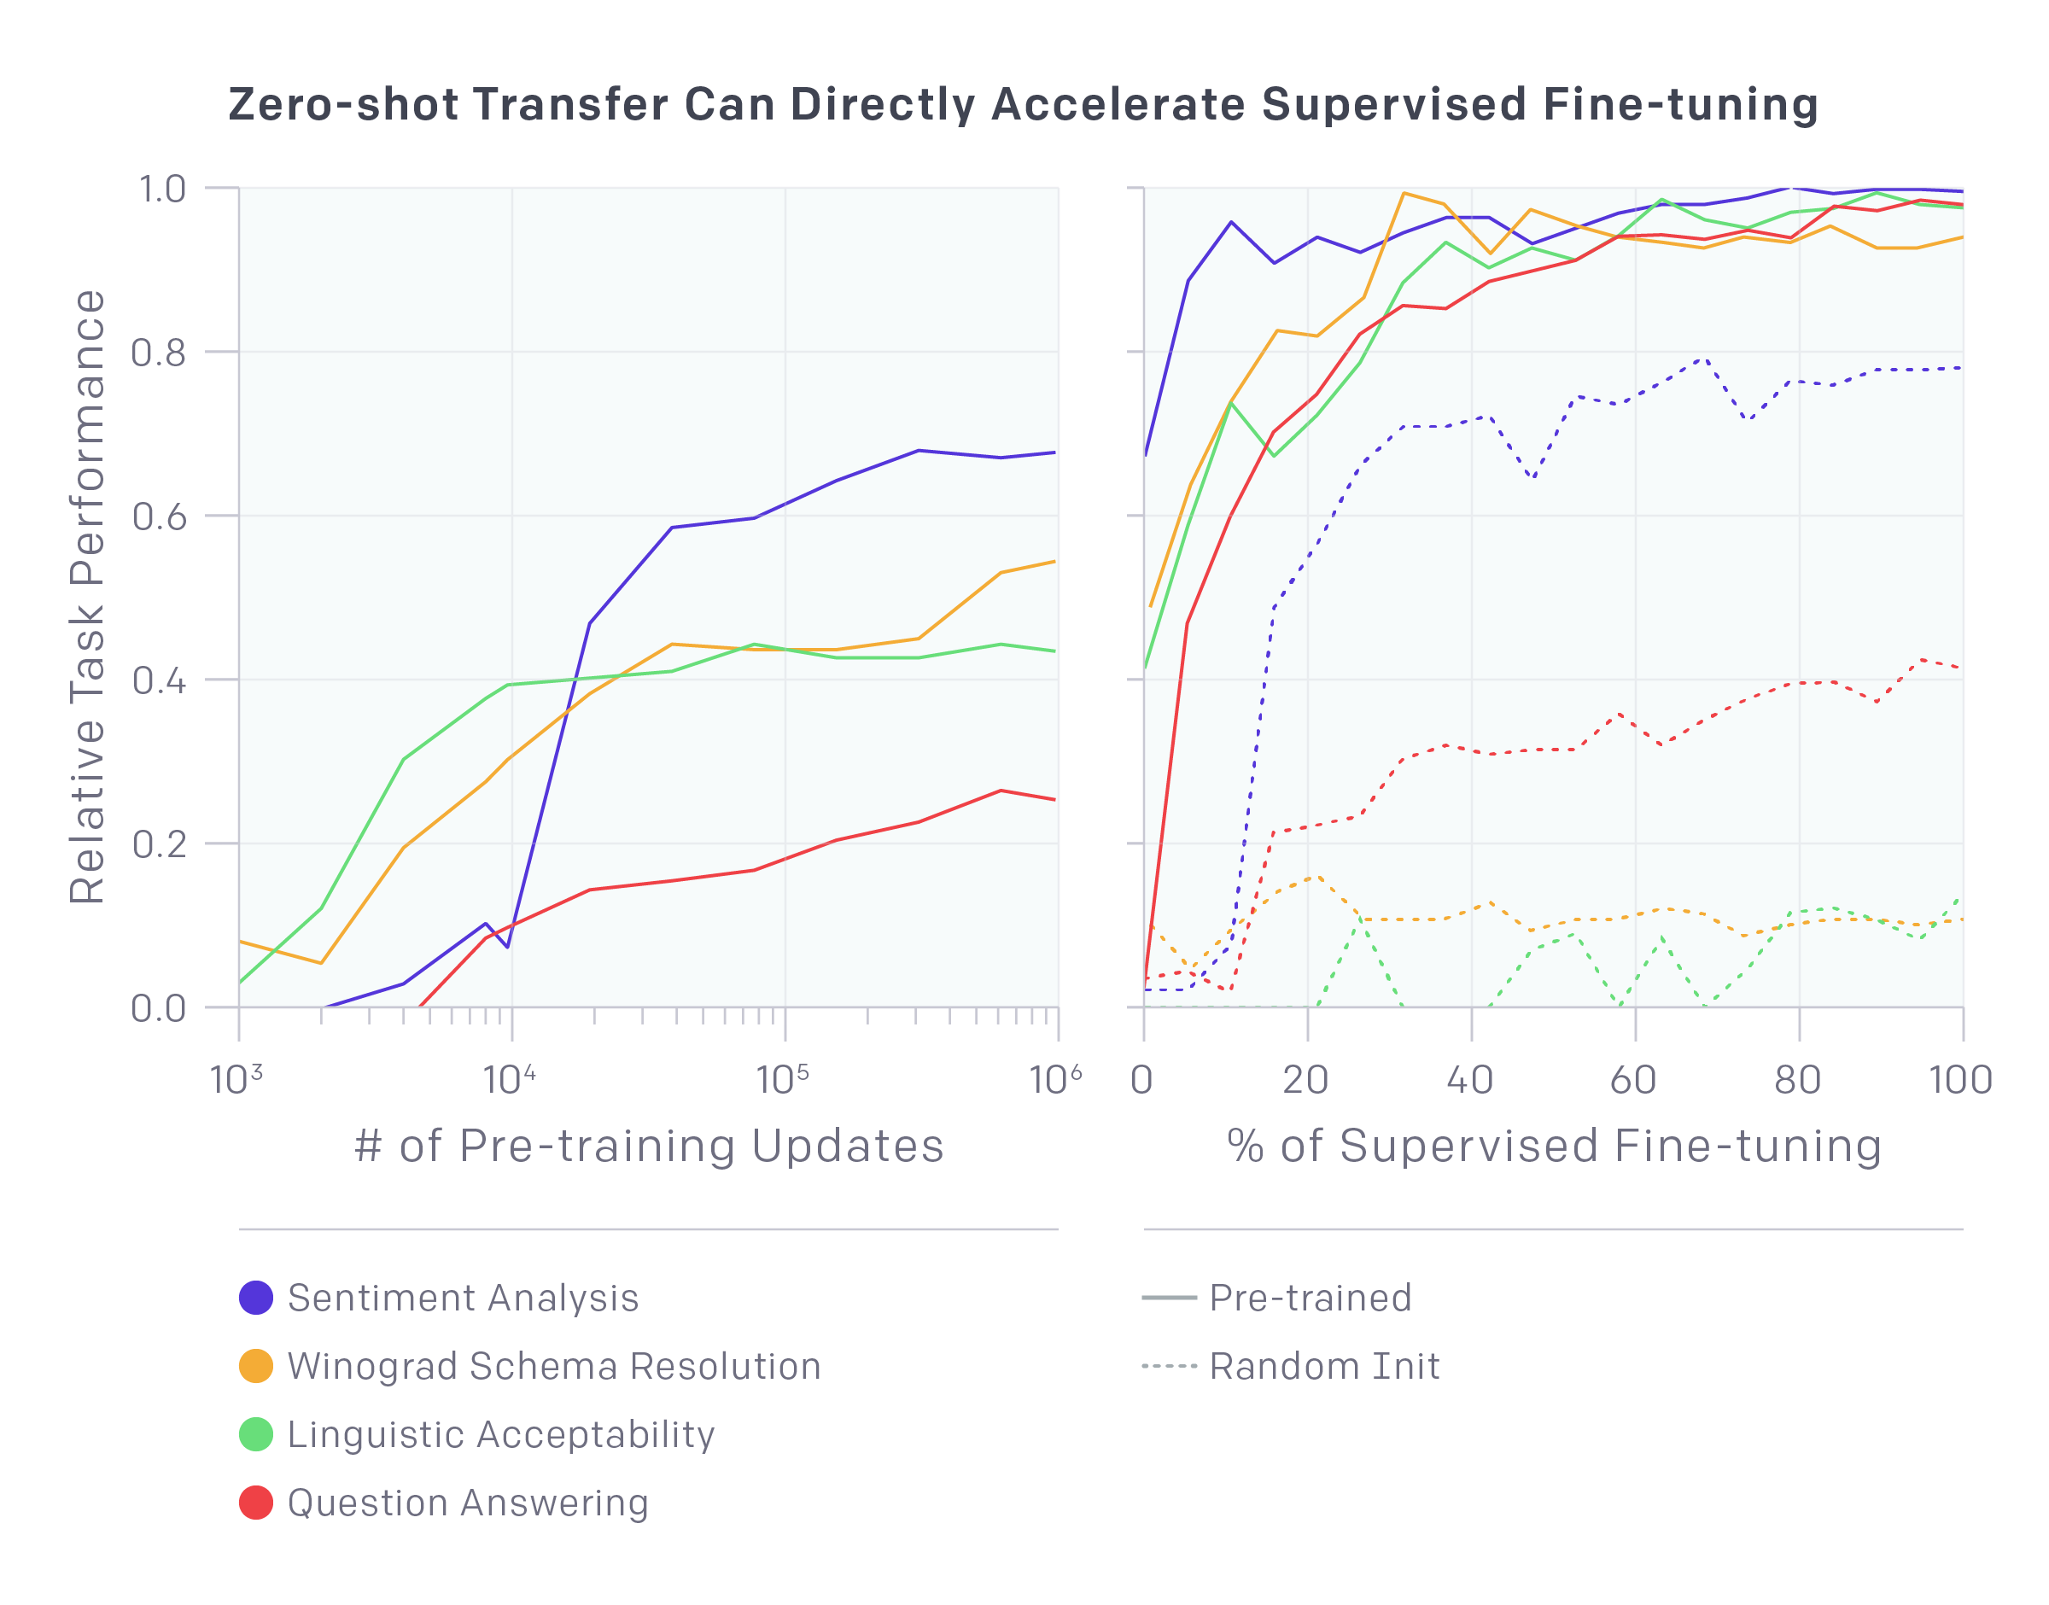
Generative Pre-Training for NLP
OpenAI: Improving Language Understanding by Generative Pre-Training
fastAI: Universal Language Model Fine-tuning for Text Classification
Trieu H. Trinh & Quoc Le: A Simple Method for Commonsense Reasoning

Slide 16
Hands-On: Featurizing Comments from Wikipedia Talk Edits Using Word Vectors and Language Model Encoders
Activity 1A

Slide 17
Active Learning by Uncertainty Sampling

Slide 18
Algorithm Sketch
Given an initial model, M and unlabeled set of samples U:
Using the current model M make class c likelihood predictions, P(c | U) = M(U).
Select a set to label L (possibly one) from U, based on P(c | U).
Update M with the training set T’ <- T + L
Repeat until model improvement / labeling cost < threshold
Active Learning methods differ by the way they use P(c | U) to search over the set U.

Slide 19
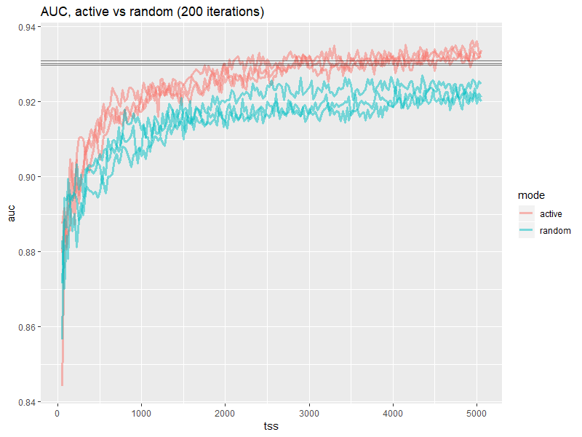
Learning curves show expected gains from Active Learning

Slide 20
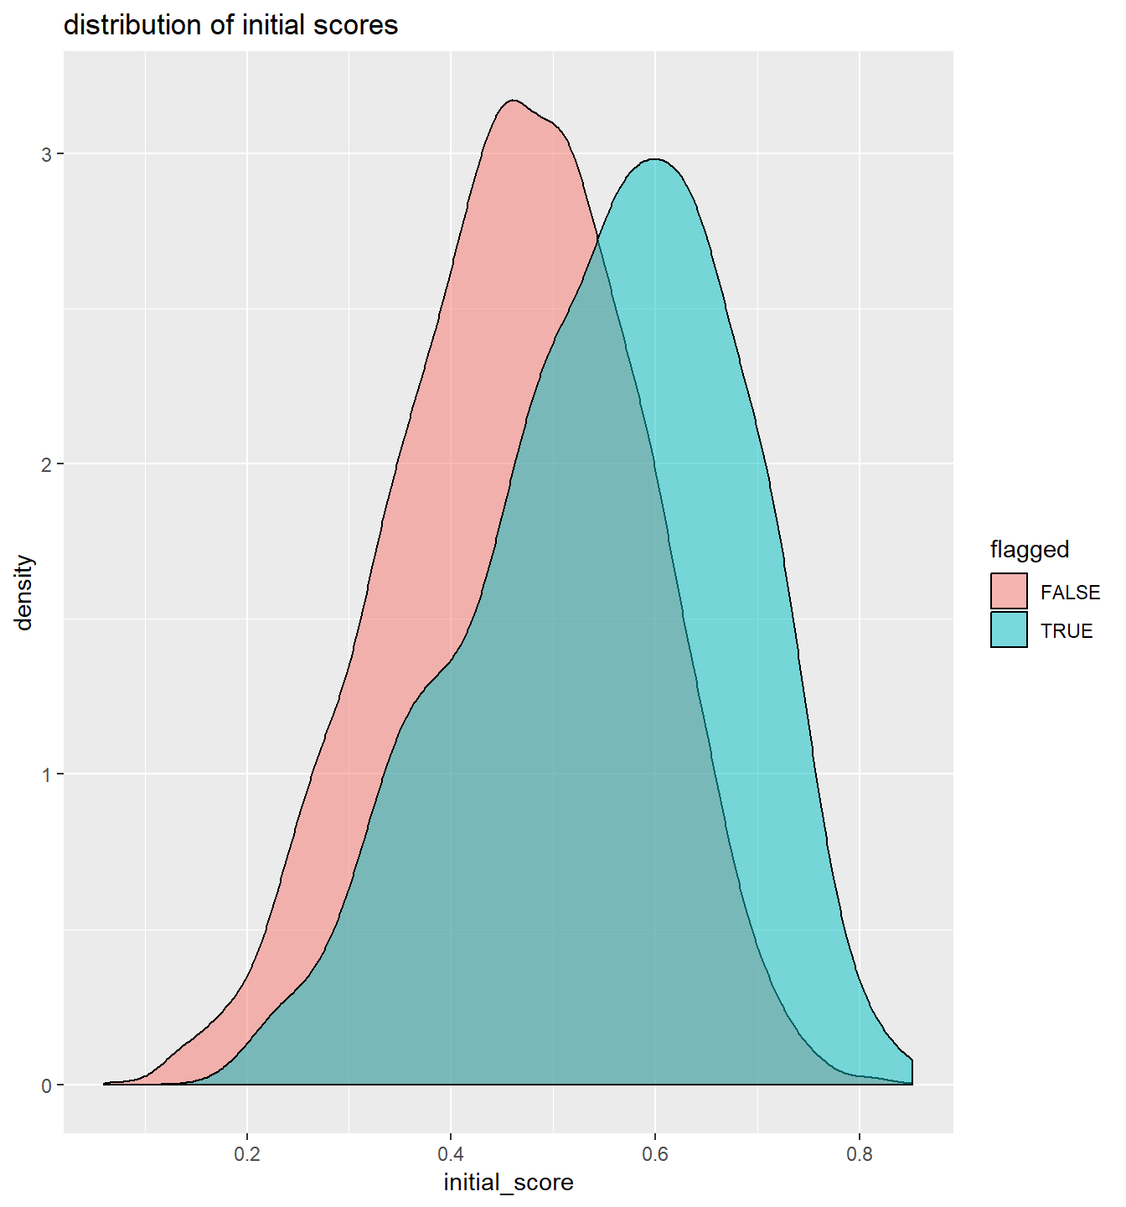
Uncertainty Sampling
The intuition is that unlabeled samples that the model predicts with greater uncertainty are more likely to be informative.
This implies a strategy to select samples assigned the most uninformative probability by the current class c likelihood P(c | U).

Slide 21
Three uncertainty-sampling sample selection methods
Methods differ by how P(c | U) is used to select from U.
Query Synthesis [Anguin, 1988]
Selective Sampling [Atlas et al. 1989 ]
Pool-based Active Learning [ Lewis & Gale, SIGIR 1994 ] [Text classification - Lewis & Gale ICML 1994 ]

Slide 22
Query Synthesis
Generate a query of where to look in the feature space x to select items to label. This applies with feature space representations where a “sample” could mean generating an x ab initio rather than selecting from an existing set U.
For example x could be an chemical synthesis, or a synthetic image whose outcome is passed to the model learner.
There’s a rough analog to the generative step in current DNN adversarial networks.

Slide 23
Selective Sampling
Choose a region in feature space to focus on that is predicted to have the greatest uncertainty or information gain.
This applies best when gaining new samples is passive or free, such as when selecting from streaming samples.
Samples are selected sequentially from the stream.
Unlike with Query Synthesis, samples are guaranteed to represent the actual distribution of the data, P(U).
For example, generate image samples by aiming a camera at areas that need clarification.

Slide 24
Pool-based Sampling
Choose greedily among the existing set of unlabeled samples U by an uncertainty measure applied to each element in the set.
Batch sampling: one or more samples may be selected at each stage.
When labelling costs vary among samples they may also be considered along with information gain.
The examples in this tutorial will demonstrate Pool-based Sampling.

Slide 25
Active learning for text classification https://github.com/Azure/active-learning-workshop/tree/master/text_classification
Activity

Slide 26
Hyperparameter Tuning Using mmlspark

Slide 27
https://github.com/Azure/active-learning-workshop/blob/master/text_classification/tuning/find-best-model.ipynb
Activity

Slide 28
Serving the Model Using mmlspark

Slide 29
https://github.com/Azure/active-learning-workshop/blob/master/deployment/TextClassificationWithMMLSpark.ipynb
Activity

Slide 30
How Uncertainty Sampling Fails

Slide 31
How Sampling Fails
P(c | u) often picks samples that are irrelevant, since there are areas of the sample space that are uncertain but do not help distinguish classes.
Example: outliers may be highly uncertain but uninformative.
Better to combine the class likelihood P(c | u, x) with the areas of feature space likely to distinguish known classes.
Learners that generate margins for the class separators can find unlabeled samples both uncertain and that discriminate strongly between classes.

Slide 32
Working in the Version Space
The space of all hypotheses is called the version space. Think all possible separators for a linear classifier.
The version space is the dual to the feature space. Active Learning can be posed as maximizing the reduction in the version space by choice of samples.
For instance, a sample that eliminates half the version space would best reduce model uncertainty.
When model predictions are uncertain there are also Bayesian interpretations of the version space.

Slide 33
Feature Space
Version Space
Classes

Slide 34
Uncertainty about uncertainty
Distribution over version spaces
1. Classifiers all consider a sample uncertain.
2. Classifiers consider a sample certain, but disagree, so on average the sample is uncertain.
Case 2. is more informative, since the “second order” uncertainty is at the version space level.
Predicted class given the version space

Slide 35
Intermission

Slide 36
Use Case 2: Building a custom image classifier for wood knots

Slide 37
Note: please, download assets for exercise
URLs: are in the tutorial readme
https://github.com/Azure/active-learning-workshop/
Unzip

Slide 38
Domain: Wood Knots and Lumber Grading
In the sawmill industry lumber grading is an important step of the manufacturing process.
Improved grading accuracy and better control of quality variation in production leads directly to improved profits.
Grading has traditionally been done by visual inspection, in which a (human) grader marks each piece of lumber as it leaves the mill, according to a factors like size, category, and position of knots, cracks, species of tree, etc.
A number of automated lumber grading systems have been developed which aim to improve the accuracy and the efficiency of lumber grading.
Notes:
In the sawmill industry lumber grading is an important step of the manufacturing process. Improved grading accuracy and better control of quality variation in production leads directly to improved profits. Grading has traditionally been done by visual inspection, in which a (human) grader marks each piece of lumber as it leaves the mill, according to a factors like size, category, and position of knots, cracks, species of tree, etc. Visual inspection is often an error prone and laborious task. Certain defect classes may be difficult to distinguish, even for a human expert. To that end, a number of automated lumber grading systems have been developed which aim to improve the accuracy and the efficiency of lumber grading.

Slide 39
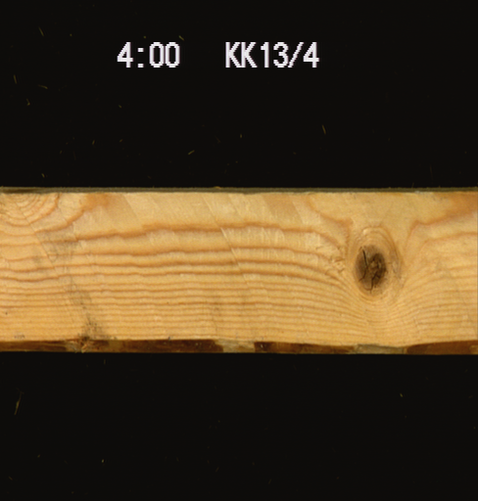
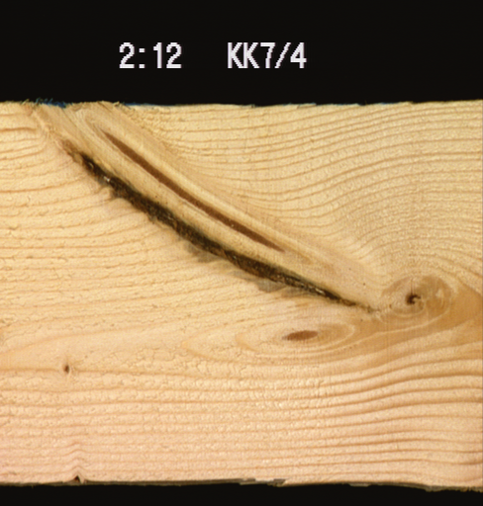
Data: pictures of boards
Notes:
In the sawmill industry lumber grading is an important step of the manufacturing process. Improved grading accuracy and better control of quality variation in production leads directly to improved profits. Grading has traditionally been done by visual inspection, in which a (human) grader marks each piece of lumber as it leaves the mill, according to a factors like size, category, and position of knots, cracks, species of tree, etc. Visual inspection is often an error prone and laborious task. Certain defect classes may be difficult to distinguish, even for a human expert. To that end, a number of automated lumber grading systems have been developed which aim to improve the accuracy and the efficiency of lumber grading.

Slide 40
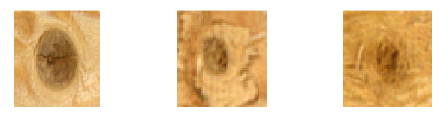
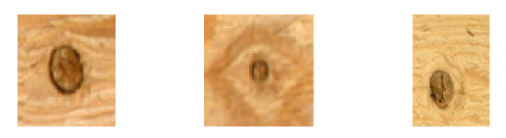
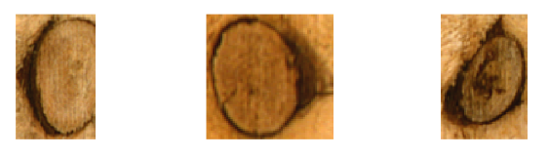
Types of wood knots
Sound knot: A knot grown firmly into the surrounding wood material and does not contain any bark or signs of decay. The color may be very close to the color of sound wood.
Dry knot: A firm or partially firm knot, and has not taken part to the vital processes of growing wood, and does not contain any bark or signs of decay. The color is usually darker than the color of sound wood, and a thin dark ring or a partial ring surrounds the knot.
Encased knot: A knot surrounded totally or partially by a bark ring. Compared to dry knot, the ring around the knot is thicker.

Slide 41
Active Learning for Object Detection

Slide 42
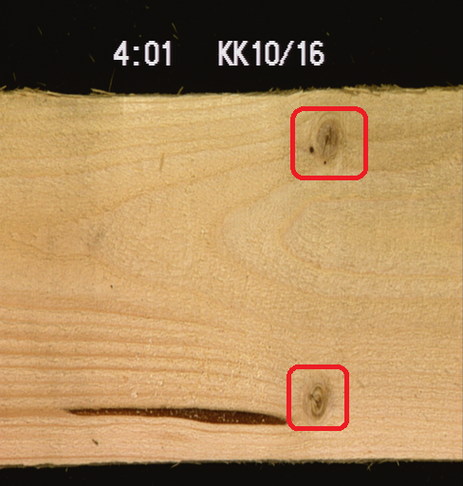
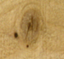
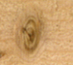
Two phase approach
Step1: prepare data for classification (do not need lumber expert)
Step2: classify wood knots images (need lumber expert to label data
Sound knot?
Dry knot?
Encased knot?
Notes:
In the sawmill industry lumber grading is an important step of the manufacturing process. Improved grading accuracy and better control of quality variation in production leads directly to improved profits. Grading has traditionally been done by visual inspection, in which a (human) grader marks each piece of lumber as it leaves the mill, according to a factors like size, category, and position of knots, cracks, species of tree, etc. Visual inspection is often an error prone and laborious task. Certain defect classes may be difficult to distinguish, even for a human expert. To that end, a number of automated lumber grading systems have been developed which aim to improve the accuracy and the efficiency of lumber grading.

Slide 43
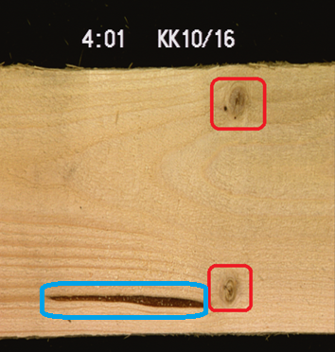
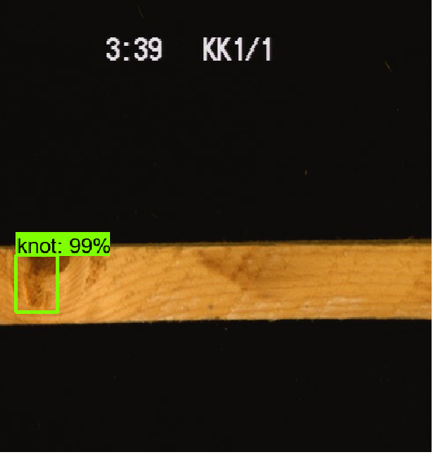
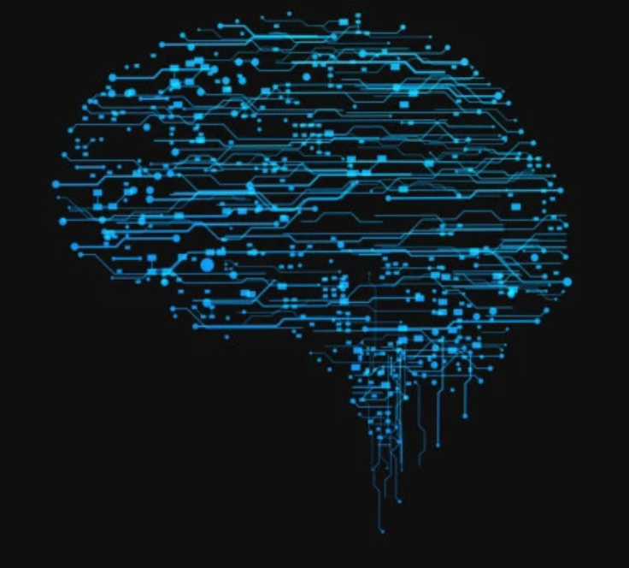
DNN Based Object detection
Rather than manually cropping knot images from boards train Object Detection model predict knots bonding boxes. Human will verify predictions and assign labels (bboxes).
Label knots and defects
Train Object Detection Model
Verify predicted bboxes
Notes:
In the sawmill industry lumber grading is an important step of the manufacturing process. Improved grading accuracy and better control of quality variation in production leads directly to improved profits. Grading has traditionally been done by visual inspection, in which a (human) grader marks each piece of lumber as it leaves the mill, according to a factors like size, category, and position of knots, cracks, species of tree, etc. Visual inspection is often an error prone and laborious task. Certain defect classes may be difficult to distinguish, even for a human expert. To that end, a number of automated lumber grading systems have been developed which aim to improve the accuracy and the efficiency of lumber grading.

Slide 44
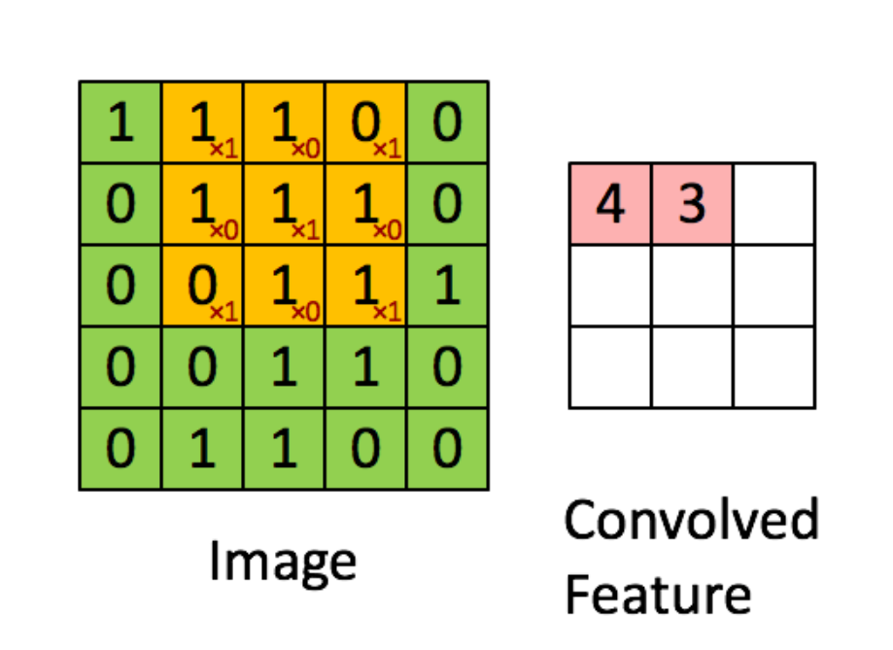
Intro to Object Detection: Convolutions
Sliding window function applied to a matrix
Element wise multiplication
Learns image features (spatial relationship between pixels is preserved)
Notes:
In the sawmill industry lumber grading is an important step of the manufacturing process. Improved grading accuracy and better control of quality variation in production leads directly to improved profits. Grading has traditionally been done by visual inspection, in which a (human) grader marks each piece of lumber as it leaves the mill, according to a factors like size, category, and position of knots, cracks, species of tree, etc. Visual inspection is often an error prone and laborious task. Certain defect classes may be difficult to distinguish, even for a human expert. To that end, a number of automated lumber grading systems have been developed which aim to improve the accuracy and the efficiency of lumber grading.

Slide 45
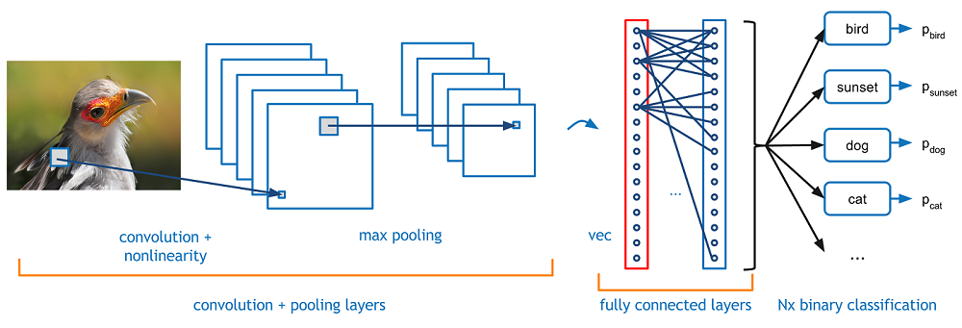
Intro to Object Detection: CNN

Slide 46
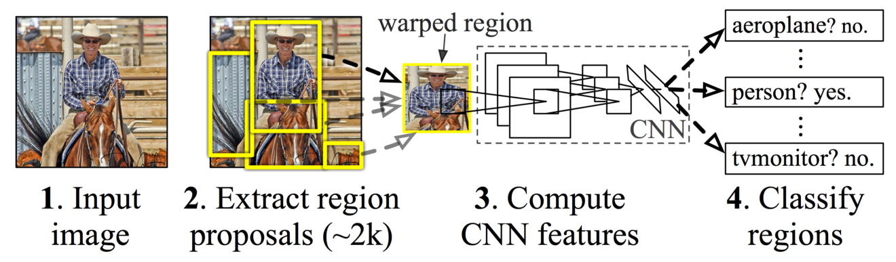
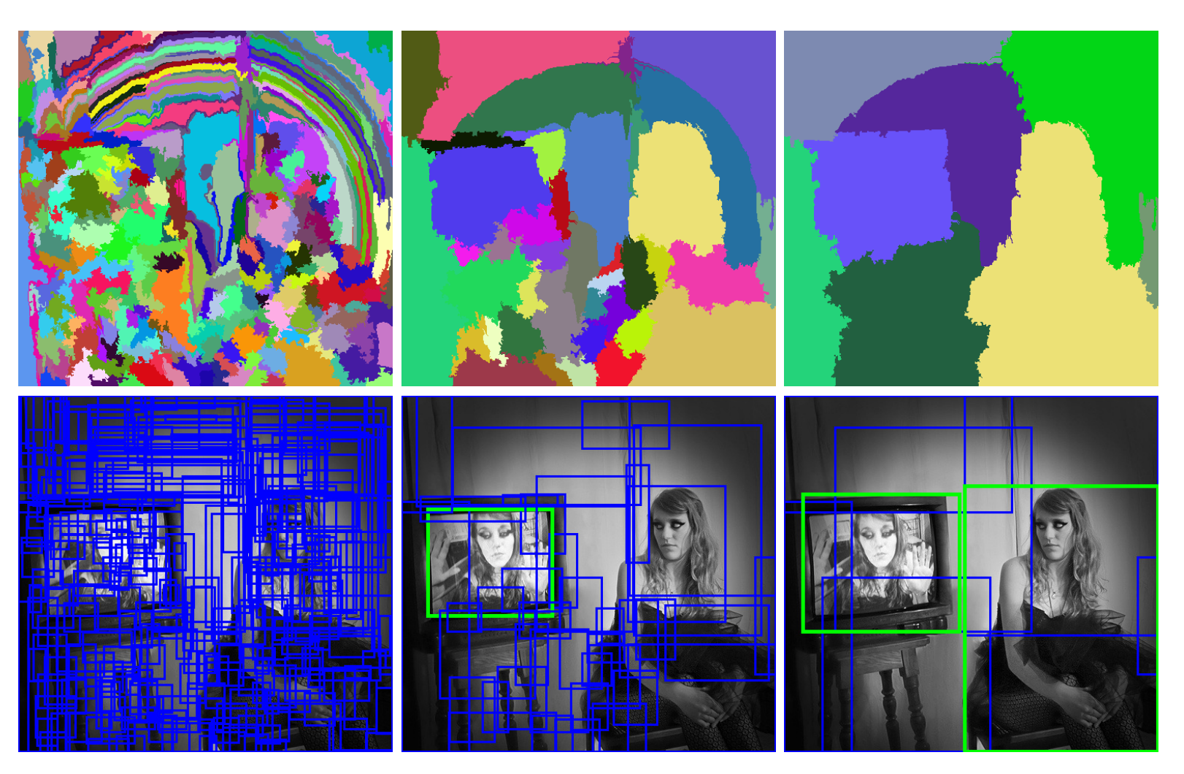
Intro to Object Detection: Region-based CNNs
CNN network
SVM
Selective search

Slide 47
Tensorflow Object Detection API
https://github.com/tensorflow/models/blob/master/research/object_detection
Variety of powerful pre-trained models :
Faster RCNN with ResNet 50, 101, 152;
RFCN with Resnet 101
SSD
Rich config files: tune learning rate, optimizer, data augmentation

Slide 48

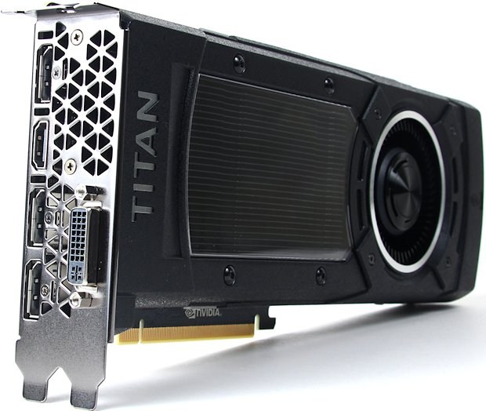


Pipeline for data labeling
https://github.com/olgaliak/active-learning-detect

Slide 49
Label initial dataset and get predictions
Spend 1-2 hours
Train simple model
Select set of images where model was less certain
Review predicted bounding boxes for knots

Slide 50
Train model #2 and get predictions
Model #2 will have more data
May need to train longer (monitor train\validation loss)
Get newer set of predicted bounding boxes for knots
…. [repeat]

Slide 51
Review pre-labeled images
Activity

Slide 52
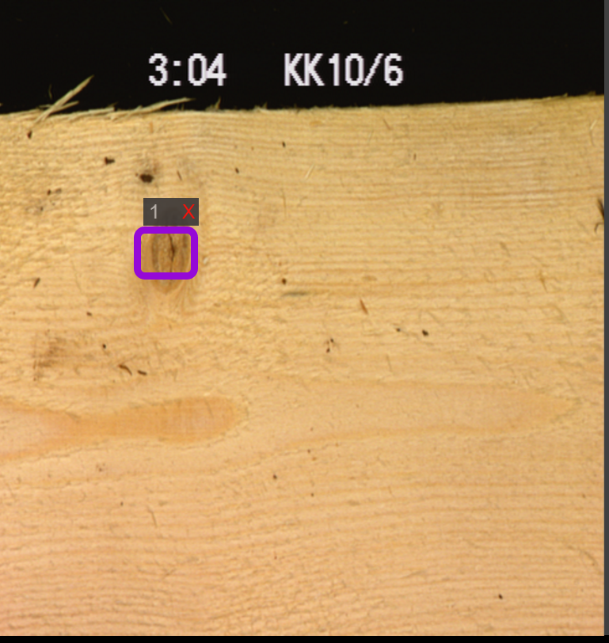
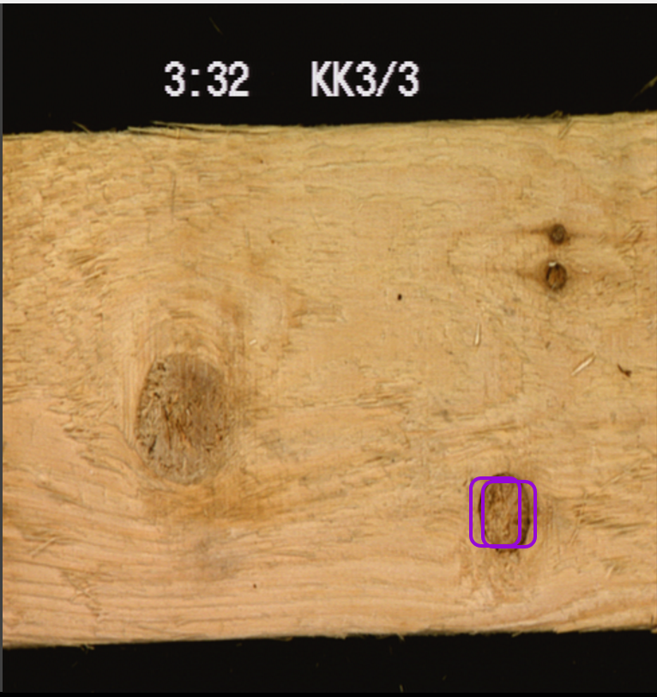
Review pre-tagging results (model 1)
Model trained only on 100 images and
Only 30 images have predictions with confidence > 70
Already able to find some notes
Model is not certain: multiple bounding boxes over one knot

Slide 53
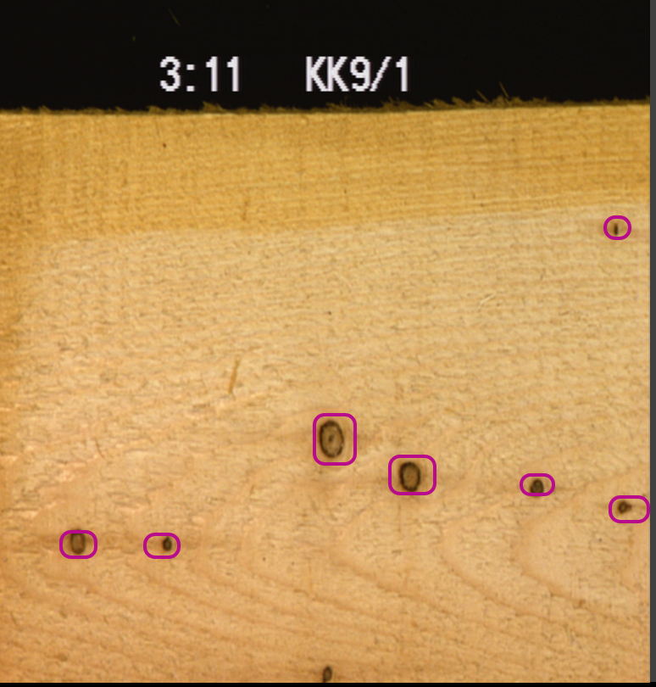
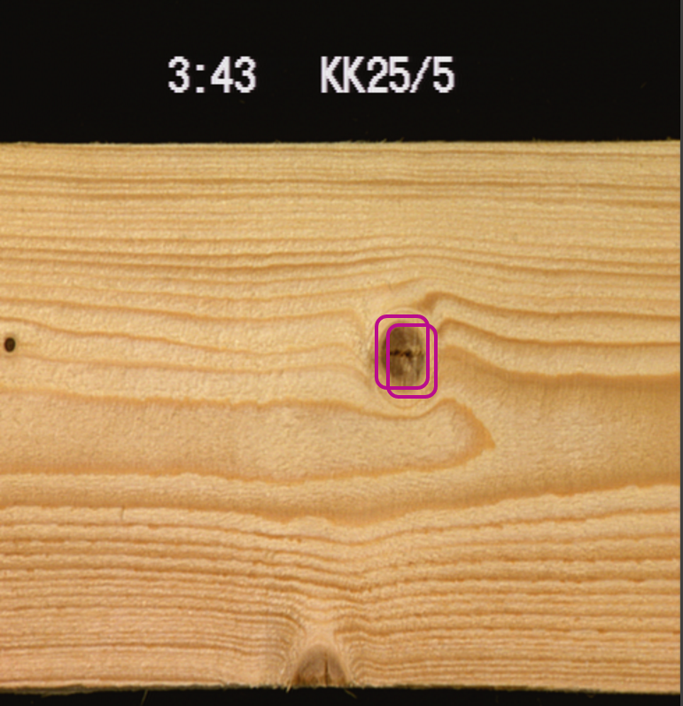
Review pre-tagging results (model 2)
Model trained on 100+30 = 130 images
100 images with predictions with confidence > 70 were reviewed
Better performance
Models is not certain: multiple bounding boxes over one knot

Slide 54
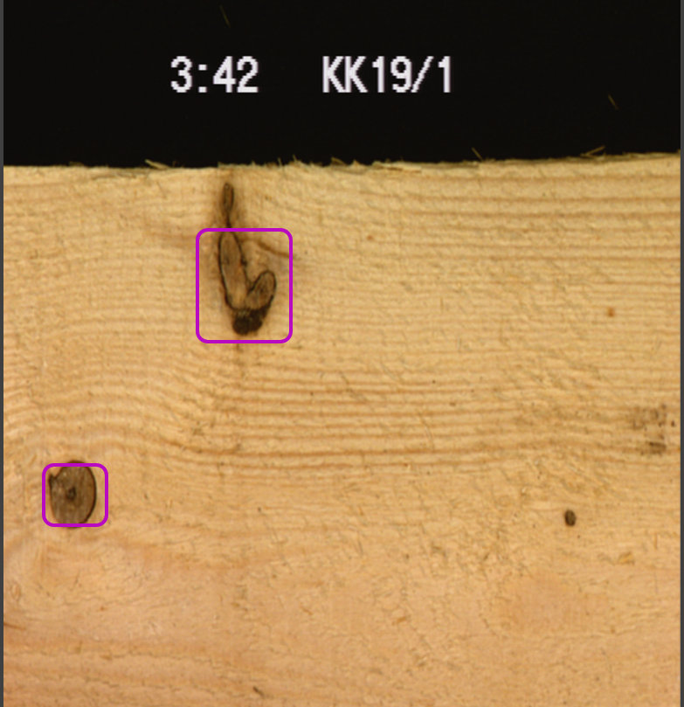
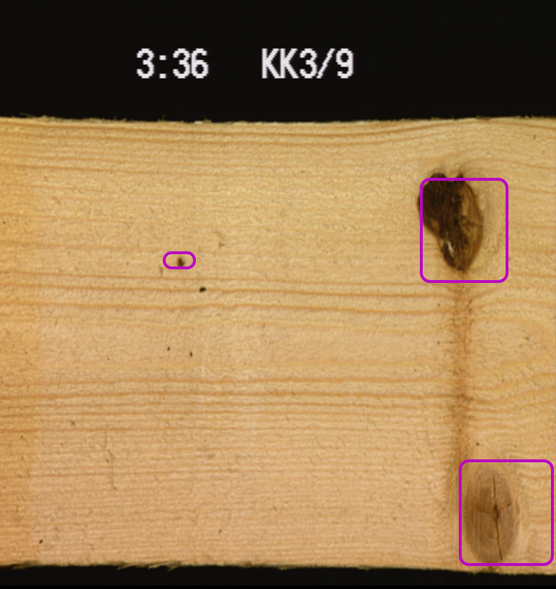
Review pre-tagging results (model 3)
Model trained on 100+30 +100= 230 images
Much less “duplication” of bboxes over one knot

Slide 55
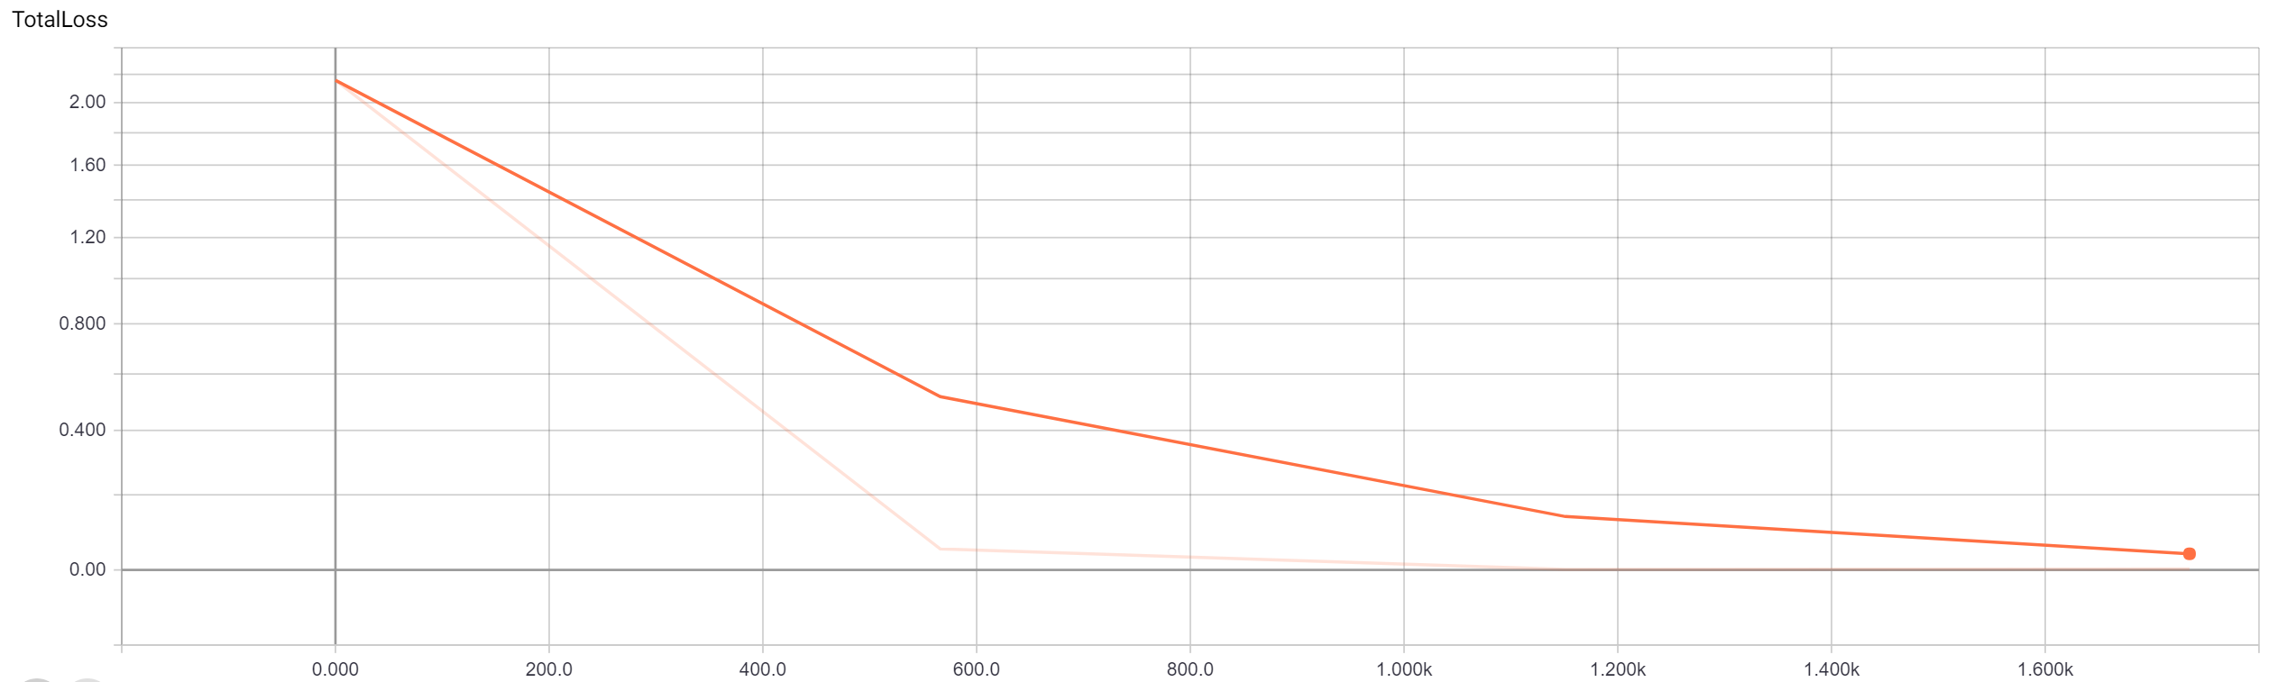
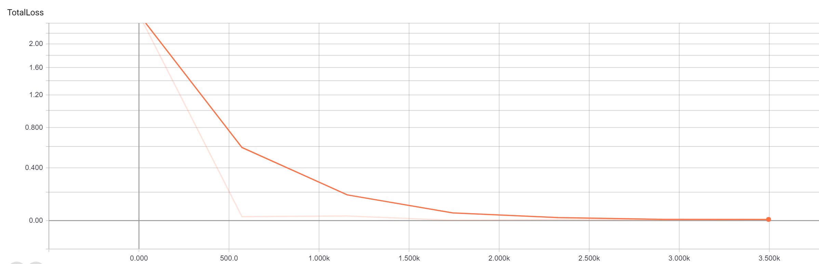
Training loss
Model 1:
Trained on 100 images
2k iterations
Model 4:
Trained on 330 images
4k iterations

Slide 56
Featurizing images at scale for building custom image classifier

Slide 57
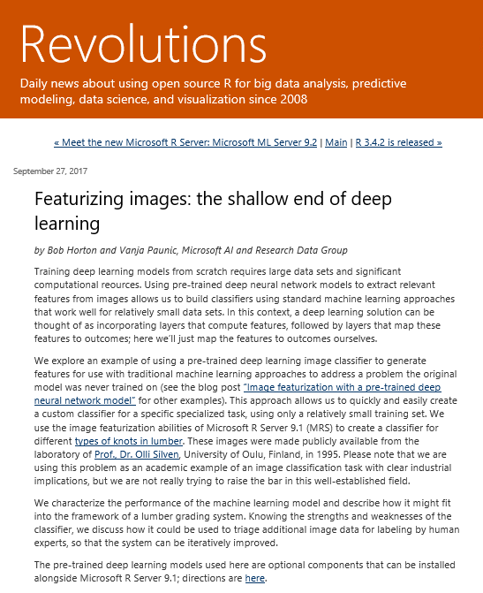
Featurizing images: the shallow end of deep learning
http://blog.revolutionanalytics.com/2017/09/wood-knots.html

Slide 58
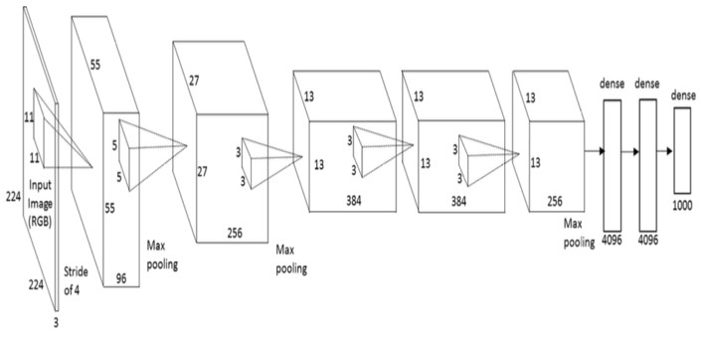
Image Featurization from a Pre-trained Model
Input image
Output features

Slide 59
Featurizing Images at Scale
Activity

Slide 60
Active learning on images
Activity

